Slide 1
Rendering with Environment Maps
Jaroslav Křivánek, KSVI, MFF UK
Jaroslav.Krivanek@mff.cuni.cz

Slide 2
Acknowledgement
Mostly based on Ravi Ramamoorthi’s slides available from http://inst.eecs.berkeley.edu/~cs283/fa10
Notes:
The term “global illumination” embraces many lighting effects encountered in real world. Some of them are shown on this slide.

Slide 3
Goal
Real-time rendering with complex lighting, shadows, and possibly GI
Infeasible – too much computation for too small a time budget
Approaches
Lift some requirements, do specific-purpose tricks
Environment mapping, irradiance environment maps
SH-based lighting
Split the effort
Offline pre-computation + real-time image synthesis
“Pre-computed radiance transfer”

Slide 4
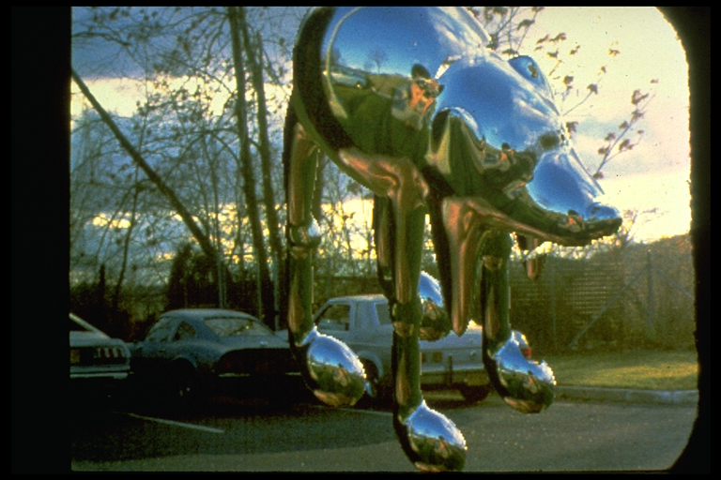
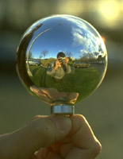
Environment mapping (a.k.a. image-based lighting)
Miller and Hoffman, 1984
Later, Greene 86, Cabral et al, Debevec 97, …

Slide 5
Assumptions
Distant illumination
No shadowing, interreflection

Slide 6
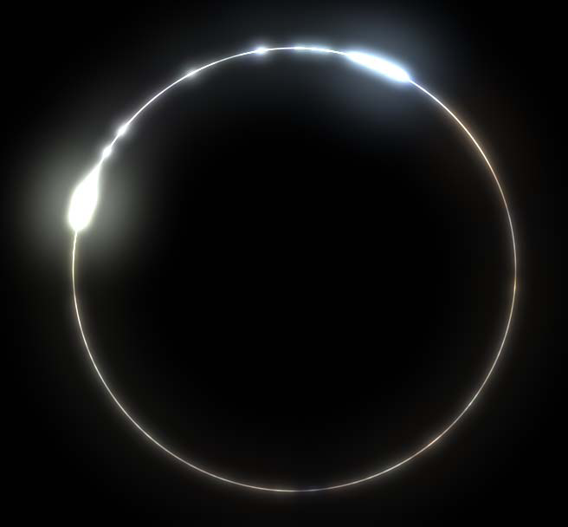
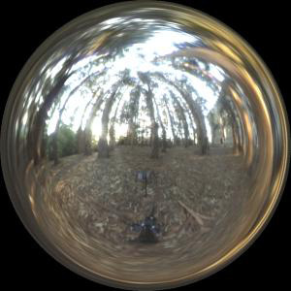
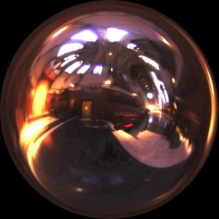
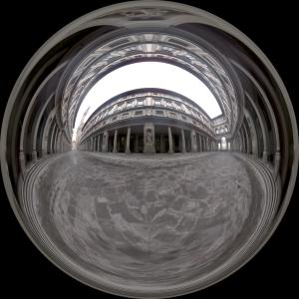
Image-based lighting
Illuminating CG objects using measurements of real light (=light probes)
Light
Eucaliptus
grove
Grace
cathedral
Object
Uffizi
gallery
© Paul Debevec

Slide 7
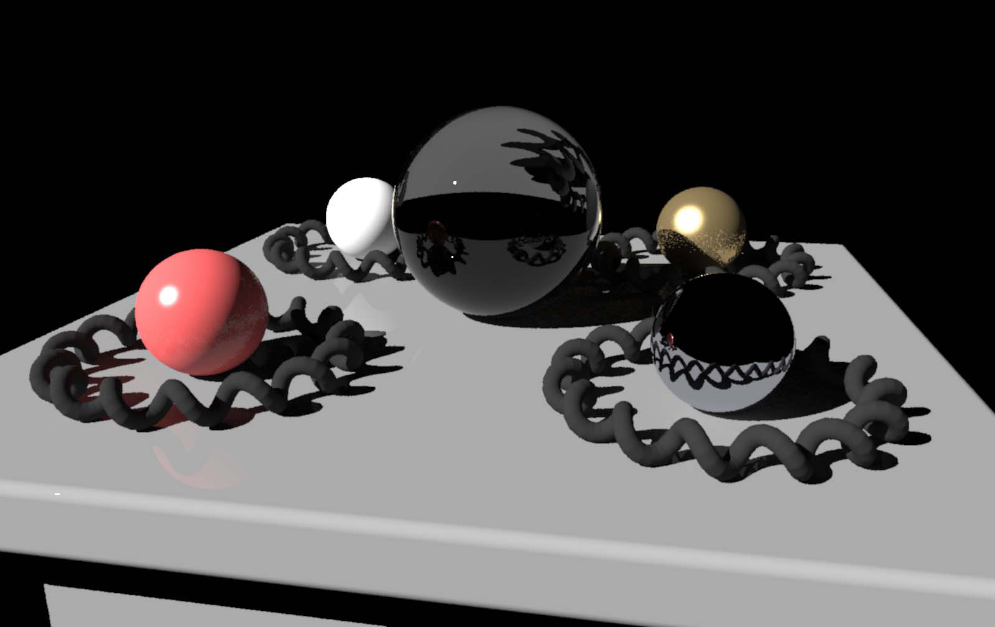
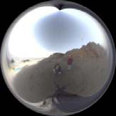
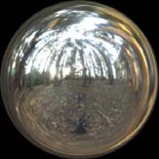
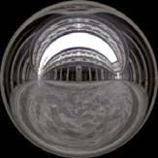
Point Light Source
Point lighting
© Paul Debevec

Slide 8
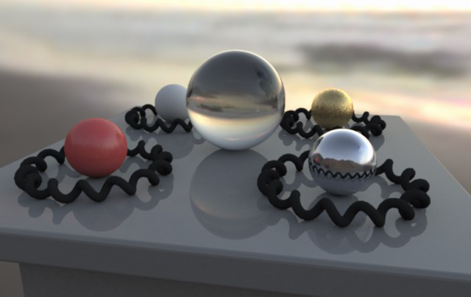
Image-based lighting
© Paul Debevec

Slide 9
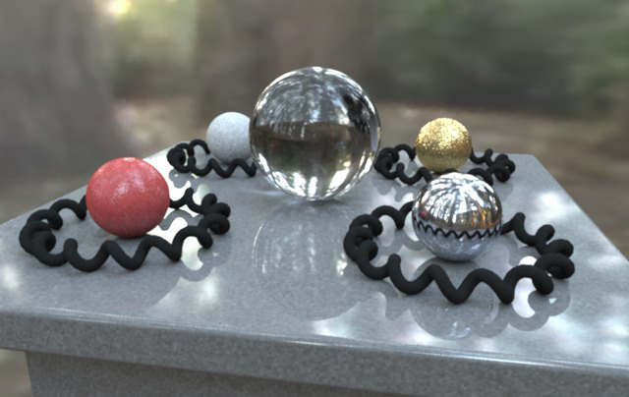
Image-based lighting
© Paul Debevec

Slide 10
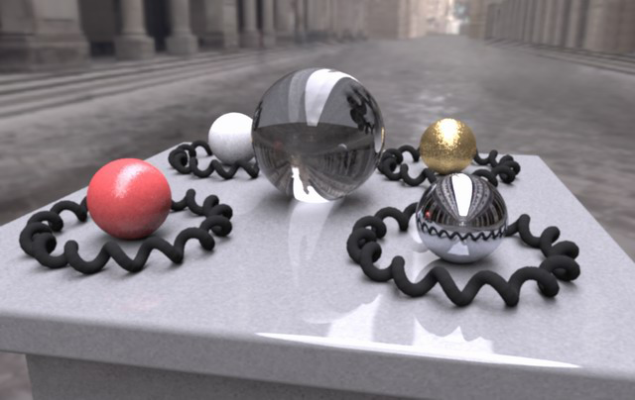
Image-based lighting
© Paul Debevec

Slide 11
Image-based lighting
© Paul Debevec

Slide 12
Video
Rendering with natural light
Fiat Lux

Slide 13
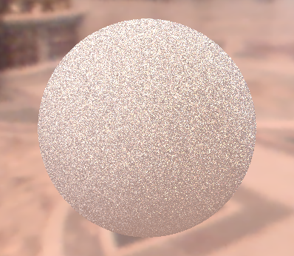
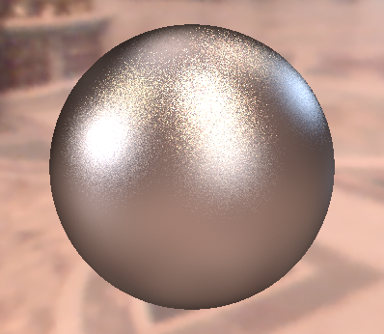
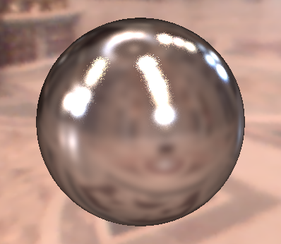
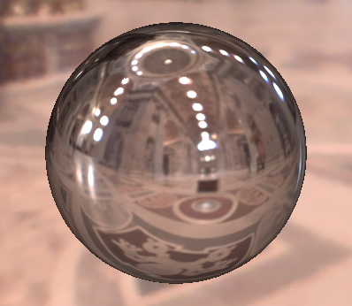
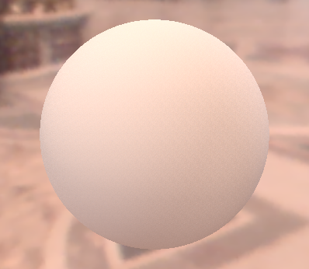
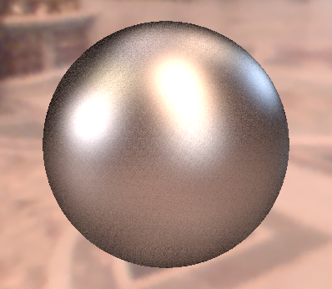
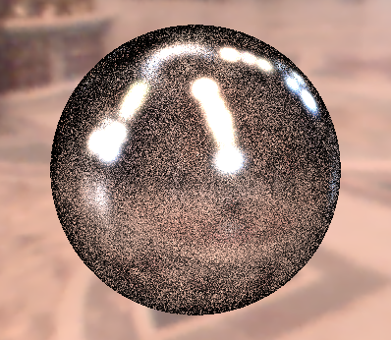
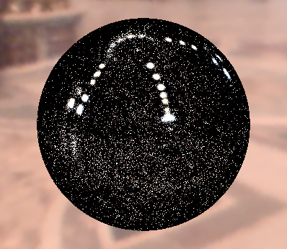
Sampling strategies
BRDF IS
600 samples
EM IS
600 samples
MIS
300 + 300 samples
Diffuse only
Ward BRDF, α=0.2
Ward BRDF, α=0.05
Ward BRDF, α=0.01

Slide 14
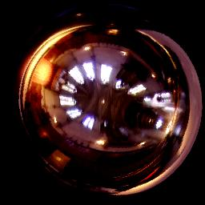
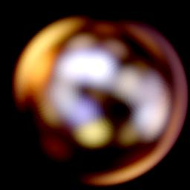
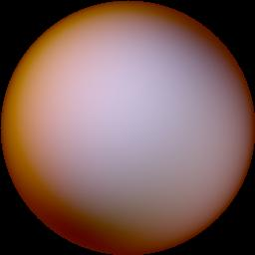
Real-time rendering
Mirror surfaces easy (just a texture look-up)
What if the surface is rougher…
Or completely diffuse?

Slide 15
Reflection Maps
Phong model for rough surfaces
Illumination function of reflection direction R
Lambertian diffuse surface
Illumination function of surface normal N
Reflection Maps [Miller and Hoffman, 1984]
Irradiance (indexed by N) and Phong (indexed by R)
Matte Sphere
Chrome Sphere

Slide 16
Reflection Maps
Can’t do dynamic lighting
Slow blurring in pre-process

Slide 17
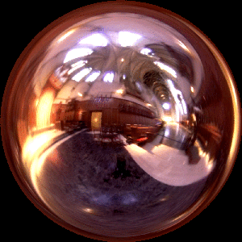
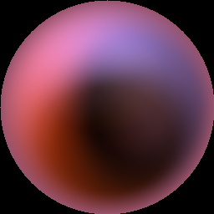
SH-based Irradiance Env. Maps
R
N
Incident Radiance
(Illumination Environment Map)
Irradiance Environment Map

Slide 18
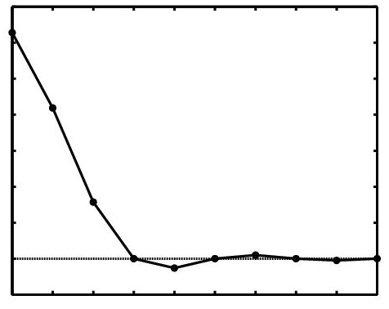
Analytic Irradiance Formula
Lambertian surface acts like low-pass filter
0
0
1
2
Ramamoorthi and Hanrahan 01
Basri and Jacobs 01

Slide 19
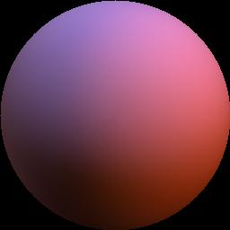
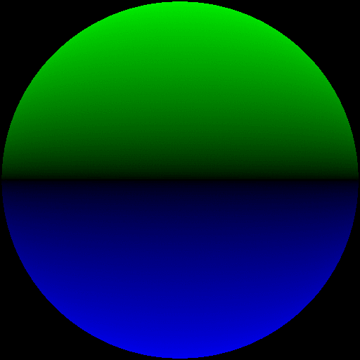
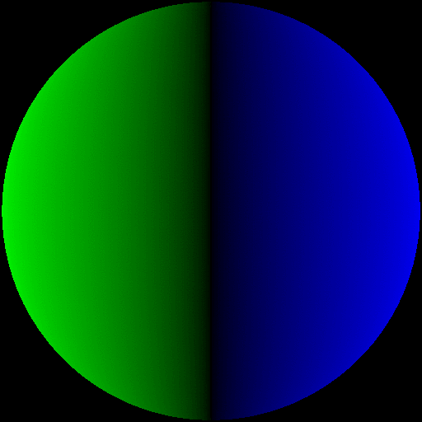
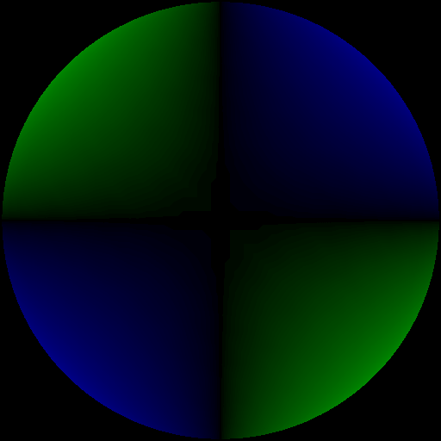
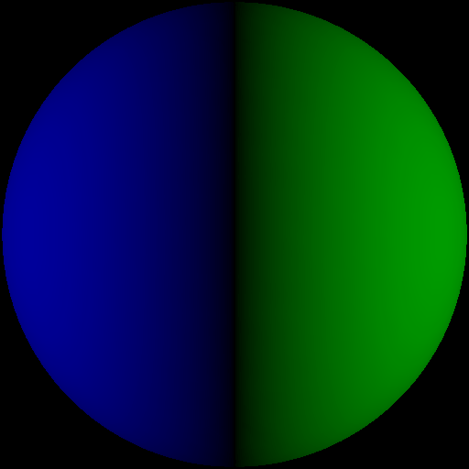
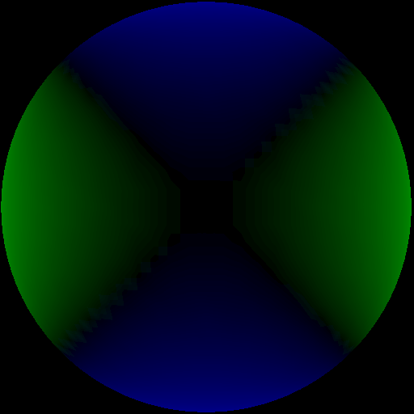
9 Parameter Approximation
Order 0
1 term
Exact image
RMS error = 25 %
0
1
2
-2
-1
0
1
2

Slide 20
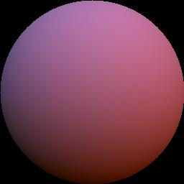
9 Parameter Approximation
Order 1
4 terms
Exact image
RMS Error = 8%
0
1
2
-2
-1
0
1
2

Slide 21
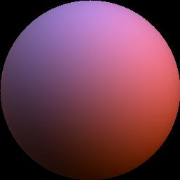
9 Parameter Approximation
Order 2
9 terms
Exact image
RMS Error = 1%
0
For any illumination, average
error < 3% [Basri Jacobs 01]
1
2
-2
-1
0
1
2

Slide 22
Real-Time Rendering
Simple procedural rendering method (no textures)
Requires only matrix-vector multiply and dot-product
In software or NVIDIA vertex programming hardware
Widely used in Games (AMPED for Microsoft Xbox), Movies (Pixar, Framestore CFC, …)

Slide 23
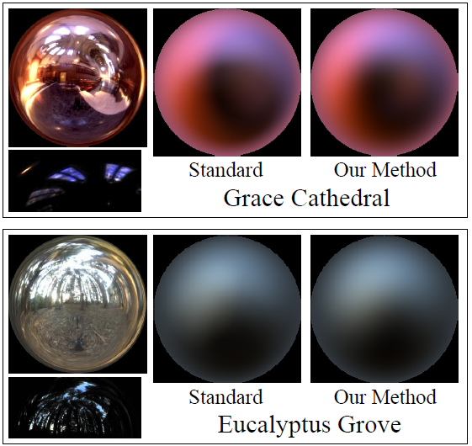
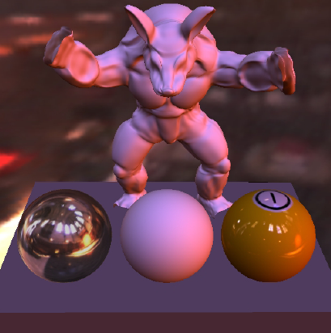
SH-based Irradiance Env. Maps
Images courtesy Ravi Ramamoorthi & Pat Hanrahan

Slide 24
Video – Ramamoorthi & Hanrahan 2001

Slide 25
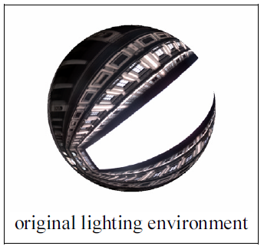
SH-based Arbitrary BRDF Shading 1
[Kautz et al. 2003]
Arbitrary, dynamic env. map
Arbitrary BRDF
No shadows
SH representation
Environment map (one set of coefficients)
Scene BRDFs (one coefficient vector for each discretized view direction)

Slide 26
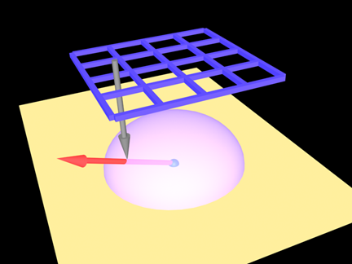
SH-based Arbitrary BRDF Shading 2
BRDF Representation
BRDF coefficient vector for a given ω_{o}, looked up from a texture (use e.g. paraboloid mapping to map ω_{o} to a texture coordinate)
BRDF coefficients pre-computed for all scene BRDFs (SH projection)
Notes:
For a given, fixed, outgoing direction, the BRDF lobe is a hemispherical function. We represent this function by (hemi)spherical harmonics. We discretize the outgoing directions and for each discrete outgoing direction, we compute the coefficient vector representing the BRDF lobe. This is done in pre-process.

Slide 27
SH-based Arbitrary BRDF Shading 3
Rendering: for each vertex / pixel, do
∫
(
)
Environment map
BRDF
= coeff. dot product
Notes:
To make the evaluation of the illumination integral fast, we take advantage of the dot-product property of orthonormal bases (which spherical and hemispherical harmonics are): Integral of the product of two functions can be computed as the dot product of the coefficient vectors of these function with respect to the basis. So if we represent the BRDF times the cosine term using (hemi)spherical harmonics, all we need to do in order to compute the outgoing radiance is to dot the BRDF coefficients with the incoming radiance coefficients.

Slide 28
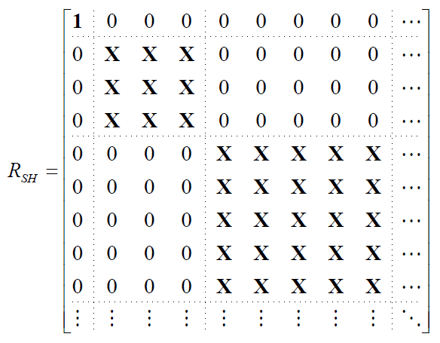
SH-based Arbitrary BRDF Shading 4
BRDF is in local frame
Environment map in global frame
Need coordinate frame alignment -> SH rotation
SH closed under rotation
rotation matrix
Fastest known procedure is the zxzxz-decomposition [Kautz et al. 2003]

Slide 29
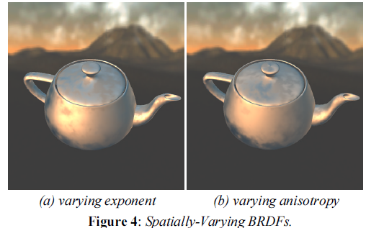
SH-based Arbitrary BRDF Shading 5

Slide 30
Video: Kautz 2003

Slide 31
Environment Map Summary
Very popular for interactive rendering
Extensions handle complex materials
Shadows with precomputed transfer
But cannot directly combine with shadow maps
Limited to distant lighting assumption

